Slide 1

Testing and Redux
LESSON 13
CFGDEGREE → FULL-STACK STREAM

Slide 2

AGENDA
01 Overview of React Testing
02 React Redux
03 Project Development

Slide 3

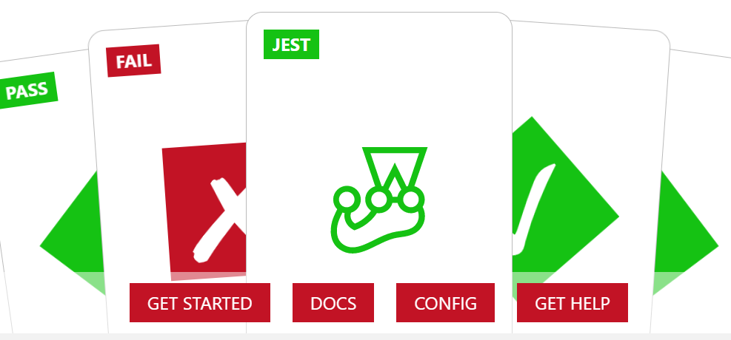
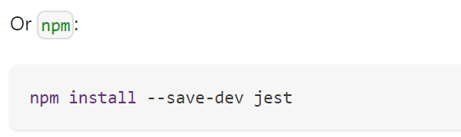
React Testing (Pt. 1)
Introducing Jest and other alternatives
Usually we’d like to test the components we create to ensure their reliability. We can either render component trees in a simple test environment and assert its output, or run the whole project fully in a realistic environment (testing fully everything ala end-to-end testing).
For the time being, we focus on the first case. When considering tools, we usually need to consider:
Speed vs Realism of environment: Some can help us test quickly, but the environment isn’t as good (doesn’t match a browser fully) - but improving the latter metric usually means sacrificing speed.
How much to mock: How much should be tested? The whole component? The buttons inside it? Etc
# EXAMPLE

Slide 4
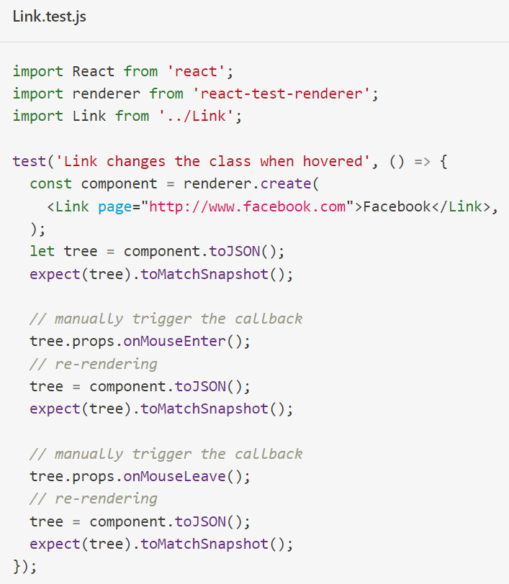
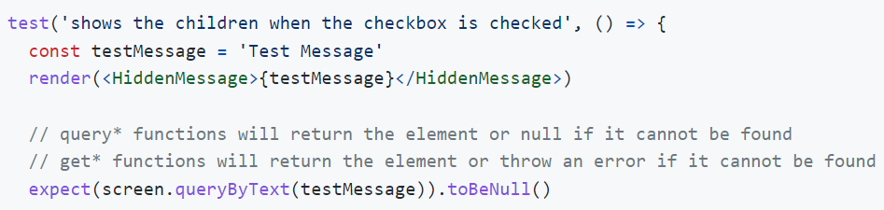
React Testing (Pt. 2)
# EXAMPLE OF SNAPSHOT CODE (JEST)
Introducing Jest and other alternatives
For the time being, we’ll cover Jest - this is a popular JavaScript testing library that can be applied to React (and is regularly applied so at Facebook!).
Through Jest, we can create ‘snapshots’ of expected component behaviour, and compare future snapshots to the original one in order to see if anything has changed or not (allowing us to catch erroneous or abnormal changes that we wouldn’t have expected otherwise).
We can also assert and test components through complementary tools like React Testing Library too! Installable via npm, this also allows us to deploy tests on the React DOM.

Slide 5

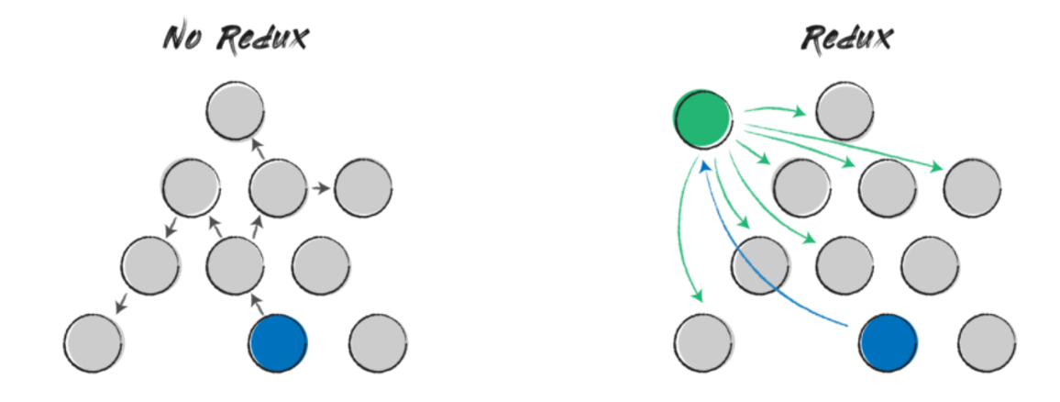
Introducing Redux
One of the best tools you may have for React
There is a lot to cover regarding Redux (and not a lot of time), but the key takeaway that you should know is that Redux provides us a global store.
So far we’ve been utilising information ordinarily through props (passing component to component) or state (holding component information in itself, perhaps if it needs to be shared we can use props).
A global store acts like a bank - all components can deposit (dispatch) information into it (e.g. new data) as well as withdraw (fetch) any data. This can happen irregardless of the components location in the hierarchy (see right diagram - green for withdrawal, blue for deposit).
This makes it easy to share information between components without tricky maneuvers (e.g. pass this prop to xyz component in xyz order to make sure it gets in the right location).

Slide 6
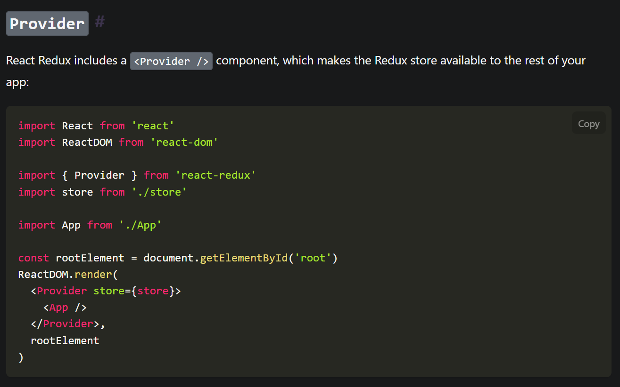
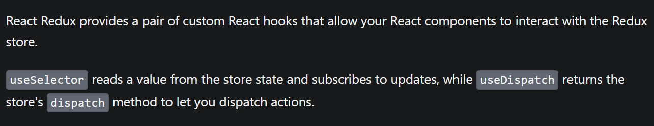
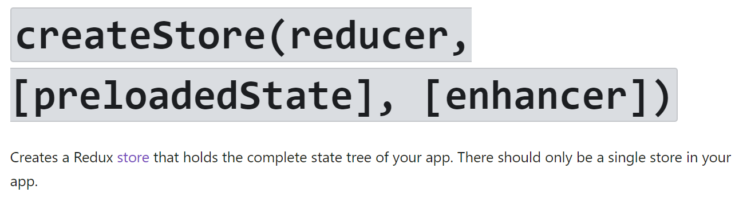
# EXAMPLE
Redux at a glance
And how to set it up!
The entirety of the app is surrounded / nested by a ‘Provider’ component - this makes the Redux store / global bank available for all other descending components in the hierarchy
Components then utilise React hooks provided from Redux to interact with the store - useSelector links you to the store (e.g. to read information, subscribe for updates if any changes occur) whilst useDispatch is used for sending action
Actions are effectively ‘information changes’ - an action could be increment which is simply saying increase the value held in store by 1. It’s a fancy wrapper for effectively saying ‘please carry out this x data modification’).

Slide 7
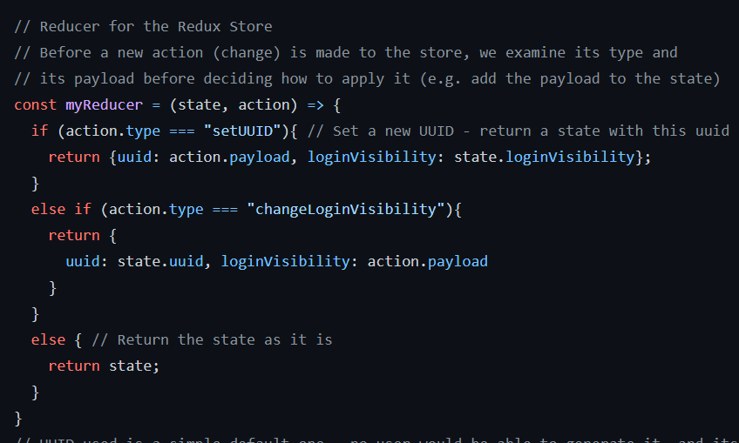
Reduce, Reuse, Recycle!
Introducing Reducers in Redux
# EXAMPLE OF A REDUCER (FROM A PERSONAL PROJECT)
KEY TAKEAWAY SHOULD BE HOW THE STORE IS CHANGED DEPENDING ON THE ACTION TYPE.
The idea of actions is similar to postal envelopes - the envelope has a stamp (denoting the type of envelope and postage) and a letter (its payload). Standard convention dictates that actions (these objects we dispatch to change the Store) should be the same (have a type and payload).
Most Redux setups then have ‘reducers’ - these are like the postmasters; they receive the action, and determine how the Store should be modified based on the action type and payload. Note that changes to the Store transform it wholly - hence the need for these security-like bouncers who check what’s being received before any change is allowed.

Slide 8
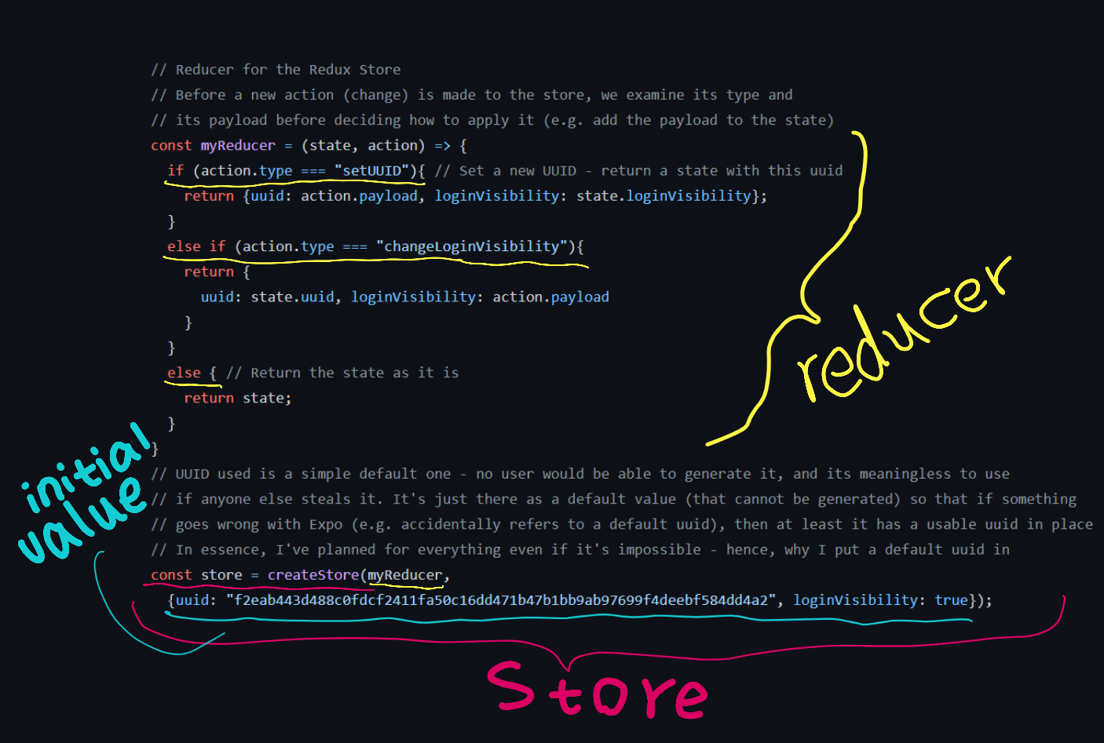
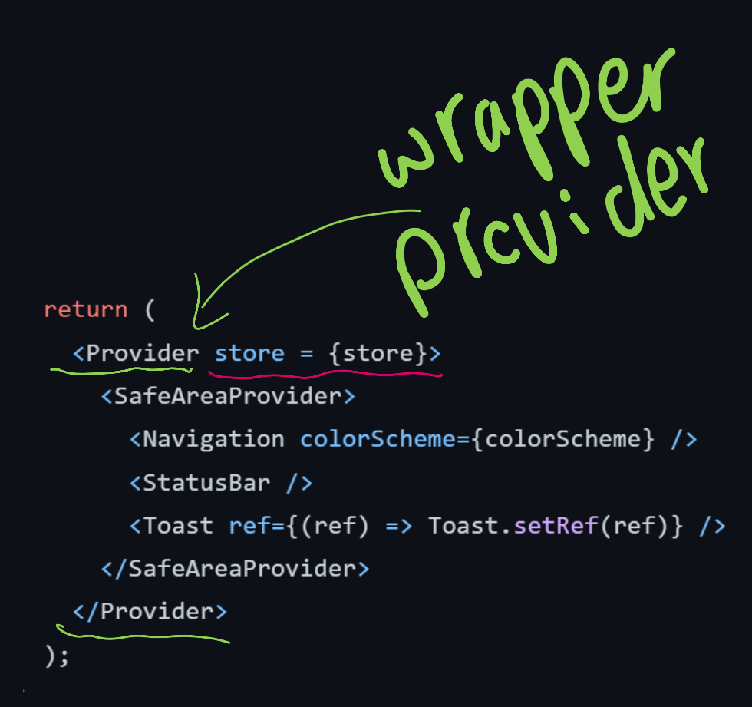
Code explanation: Setting up Store (Pt. 1)
Doing a demo explanation of Store, Reducer, etc
You can see the store being created, alongside its reducer mechanism - and assigned to the wrapper / nesting Provider! This enables all other components to access this global store now.

Slide 9
Code explanation: Setting up Store (Pt. 2)
Doing a demo explanation of Store, Reducer, etc
One quick note about reducers: they have to return the entirety of the state. So when you return something, that is the entire new state from that point on - you’re not appending via reducers, you’re overwriting each time!
We have to return a state each time - hence if there’s no action operated on, still return the state anyway (e.g. per the else {} section).
So if you want to add to a state and append something, use a notation like …state + xyz (or similar - there are syntaxes for effectively copying the previous object and appending it to a new part).

Slide 10
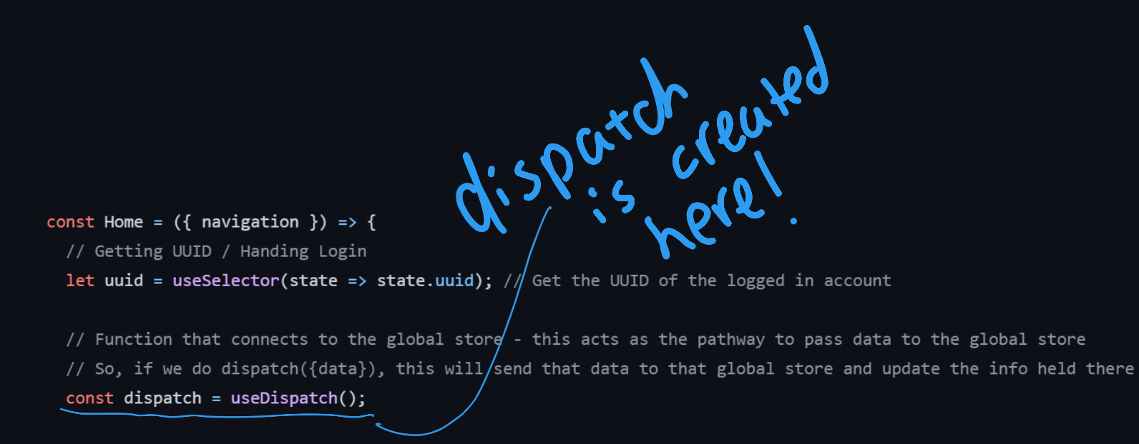
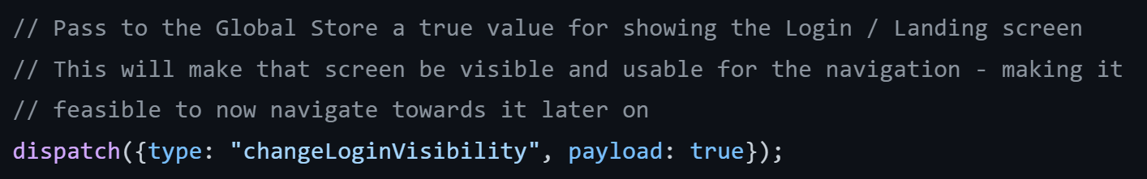
Code explanation: Setting up Store (Pt. 3)
Doing a demo explanation of Store, Reducer, etc
Here, in a separate component, we can call the useDispatch hook to get access to ‘dispatch’ mechanism - when we call it like a function later, we can pass {data} to our store!
The useSelector similarly is used to grab information from our Store. In this project, there was a need for having access to a UUID (user identifier) at all times - through this hook, all components can have access to it from the global store easily.

Slide 11
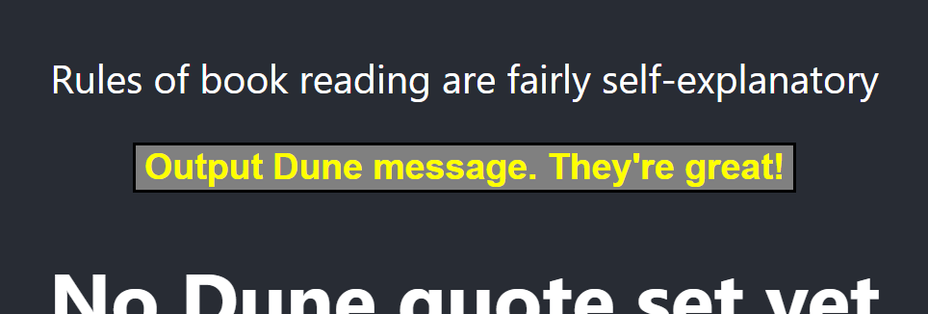

Exercise: Add Redux to your project!
Ensure that your button component (any) now displays a text using info held from a global store
For this exercise, modify your project to fulfill the following:
Create a global store (think of Provider, CreateStore, a Reducer, etc!). Give this store a default message value (e.g. “Hello World”).
In your button component, use the appropriate hook to grab the message from the global store (e.g. think of useSelector!) and display this value in the button as text (e.g. ‘Output Dune message…’).
As a extra challenge, as extension, modify the onClick to dispatch new message values to the store so the button text changes per click!
# THIS BUTTON SHOULD NOW DISPLAY WHATEVER THE STORE HOLDS
You have approx. 40 minutes for this (depending on your instructor's discretion + current time!). Google when you can! Use documentation!

Slide 12

PROJECT WORK
For the remaining time work in your designated groups on your projects
Instructors are available to help if you have any questions or would like to bounce some ideas around with regards to implementation.

Slide 13
SUMMARY
Testing for React can be achieved through a myriad of tools - however, a key consideration is how much to test (depth vs speed - as one would compromise the other).
Information can be stored globally in a Redux ‘store’ - this allows components to have a centralised bank of information that they can access anytime

Slide 14
THANK YOU!

